Slide 1
CS315 – Project Two (optional game title)
Spencer Smith
{ link to game source repo }

Slide 2
Milestone 1
By this point you should have completed:
Player movement and interaction
Level design and layout
Collectibles
One bit of interactivity
DONE

Slide 3
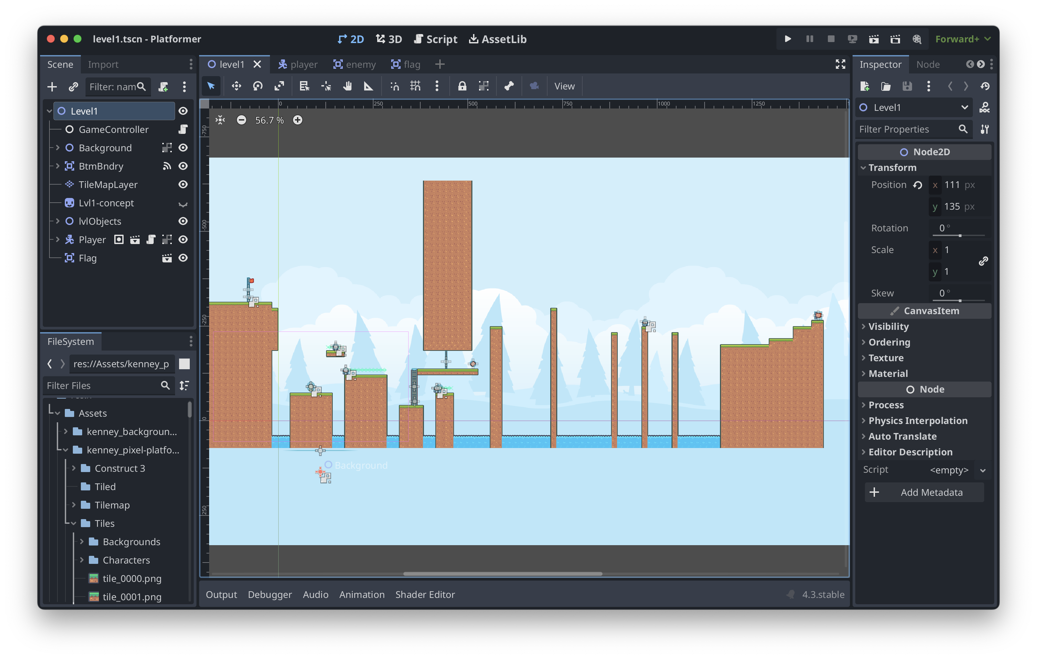
M1 – Screenshot / image

Slide 4
M1 – Question
How do I make the background repeat itself automatically?

Slide 5
M1 – Discussion
I can use a parallax background object to make my background repeat infinitely.
I should add some text in the levels about new items/abilities, rather than assuming that the player will know what stuff does.

Slide 6
M1– Technique Reflection
Starting with a blank slate is making it much easier for me to keep everything organized. I feel like, with the last project, ”taking over” someone else’s starting project made it much harder for me to keep everything clean. With this project, I started with nothing, so I have complete control over where everything goes, from the beginning.

Slide 7
Milestone 2
By the point you should have completed:
Doors / collectibles finished
User interface
Enemies added
Some “juice”

Slide 8
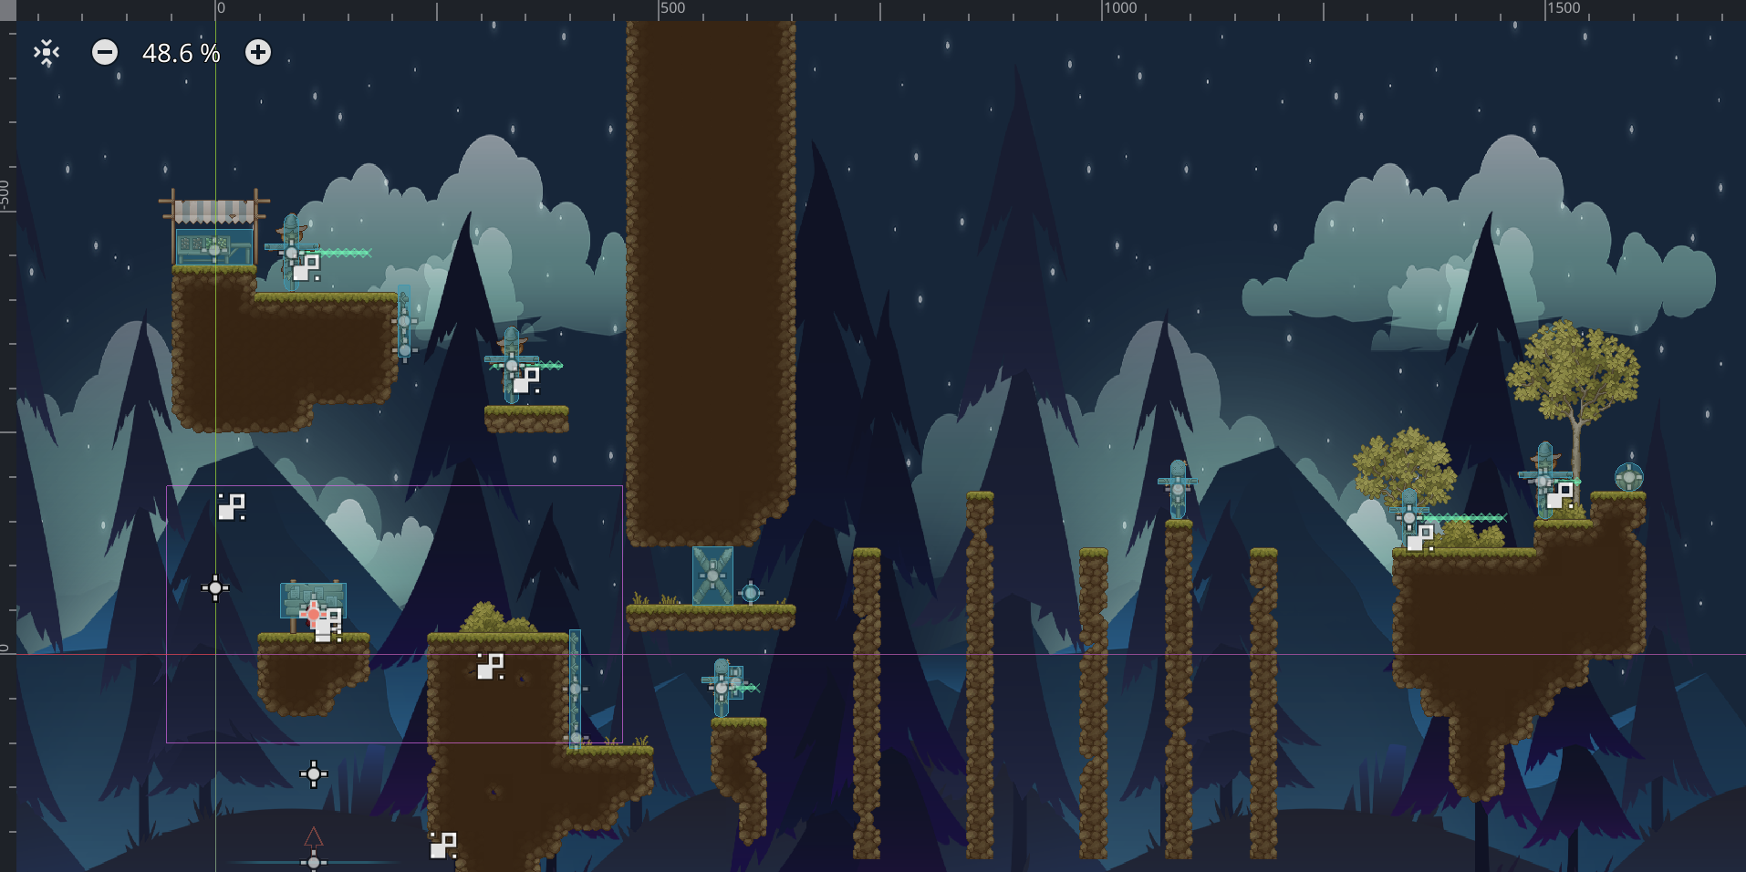
M2 – Screenshot / Image

Slide 9
M2 - Question
How much guidance should the player be given?
How can I use color to more effectively distinguish between game elements?

Slide 10
M2 - Discussion
Discuss these elements of your game
Contrasts
Pattern / rhythm in gameplay (think visual and temporal)
Code layout and structure
Messaging between elements
When is object orientation getting in your way?

Slide 11
M2 Reflection
The main thing I’m struggling with is time, honestly. I’ve been able to figure out everything that I need/want to add to my game, it just takes time. If I had to choose something that I’m struggling with (haven’t figured out yet), it would be the UI. I want to add a UI with lives and a timer, similar to Mario, but I don’t yet know how to make it so the UI stays in the same corner of the screen no matter what. I think it may have something to do with a CanvasLayer node, but I’m not sure.
In terms of what’s making sense to me, I’m really enjoying understanding the relationship between the game’s objects and the code that’s associated with them. I feel confident now in my abilities to connect signals from one side of the game to another. I can easily make things happen in the background without the player noticing. I have a much better understanding of Godot in general now than I did during project 1. I think that starting from nothing, rather than a “template” helps me with that understanding.
Code has played a large role in producing game aesthetics. One example of this is the code I use to make messages pop up. Throughout Level 1, there are a bunch of sign-posts. When the player stands close enough to them, a message pops up, explaining a new mechanic to the player. The coding has always been what I’m most confident with, so it feels really good to put my skills to use in this environment.
Overall, I’m happy with how my game is coming along. I still need to add a second level, as well as sound effects and a menu, but I don’t expect those to take me too long. I think if I were to keep working on this game for a month after I submit it, it could turn into something really cool. Nothing exactly innovative, but cool nonetheless.

Slide 12
P2 – Final Reflection
Screenshot of final product here

Slide 13
P2 – Final Reflection
Delete and add a reflection on these elements of your project
Technique & Aesthetics
Major difficulties overcome
How you’d approach differently in the future

